Slide 1
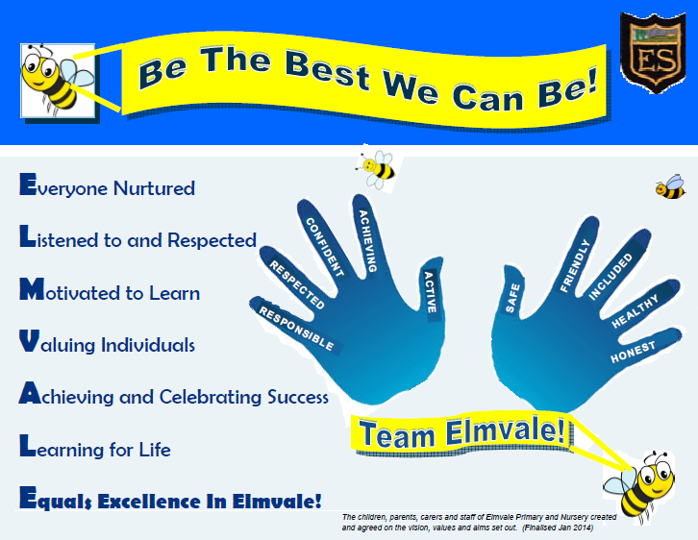

Slide 2

Elmvale Primary
Is a nurturing school

Slide 3
In our school we have a Nurture Room.
Miss Davidson and Mrs McClune work there.
We all want our school to be a nurturing school.
We are part of a nurturing city.

Slide 4
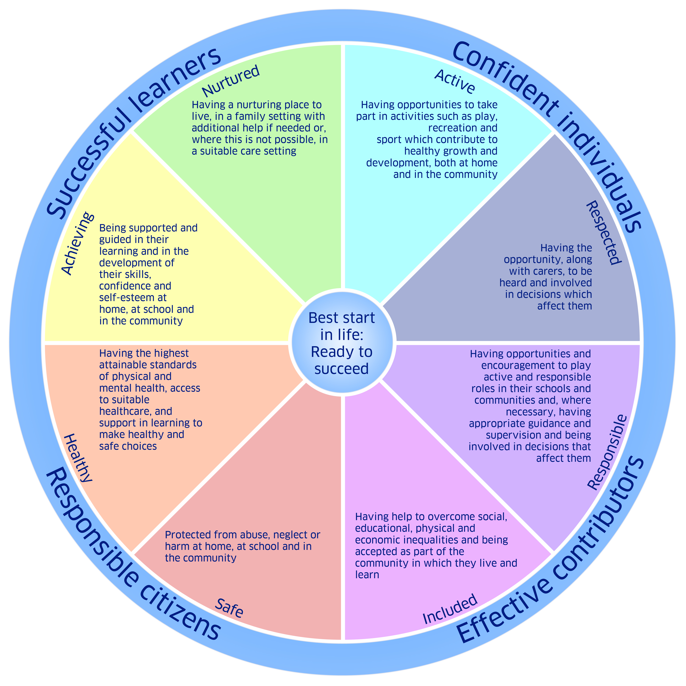
8 Indicators of Wellbeing

Slide 5
Safe
Healthy
Achieving
Nurtured
Active
Respected
Responsible
Included
Notes:
Safe – feeling protected
Take a look at the P3 display form last year
Healthy-physical activity in school and after school
Healthy choices
Achieving – supported and guided in learning, develop skills, confidence and self esteem
Nurtured –nurture at home and school. Look after each other and support
Active – Take part in activities including play, recreation and sport
Respected – to be heard and involved in decision making
Responsible – be involved in decisions that affect the child
Included – every child should have the chance to take part –Many barriers to wellbeing but it is how we overcome them. Every child is different. Every child is UNIQUE
Look at flower – every child is unique and together we are a team. Together Everybody Achieves More

Slide 6
We are all in journey. Together we can make Elmvale Primary School a Nurturing School.

Slide 7

We are all helping our school to be a nurturing school.
We work together and should always aim to....

