Slide 1
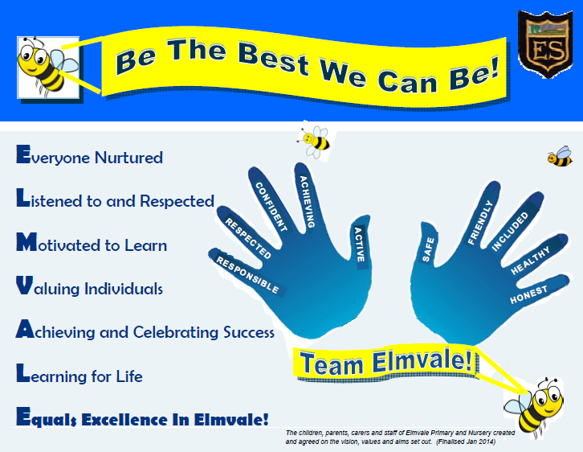

Slide 2
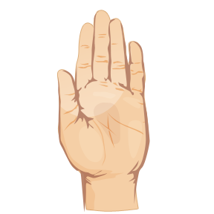
Active
Achieving
Confident
Respected
Responsible.

Slide 3

At Elmvale Primary School we are active in so many ways.
v
Football team request
Active

Slide 4

We achieve in so many ways:
  We achieve in our learning.
  We achieve in our friendships, how we look after each other and how we solve problems.
  We achieve at school and at home. We have our own personal achievements.
The pupil council would like to ask you to help them with an achievement for the school.
v
http://www.youtube.chttp://www.youtube.com/watch?feature=player_detailpage&v=qwJIhZcAd0Iom/watch?feature=player_detailpage&v=qwJIhZcAd0I
Achieving

Slide 5
We demonstrate our confidence in many different ways.
We show this in what we
Make
Say
Write
Do
v
Confident

Slide 6

We join together to celebrate in different ways.
We will be celebrating Halloween on Friday together at our Halloween Parade.
Morning – Morning nursery children, P1 –P3
Afternoon – Afternoon nursery children, P4/3 – P7
There will be two prizes per class but most of all we will have fun and show our confidence as a school team!
v
Confident

Slide 7
v
In school, we show respect by following our six Golden Rules.
It is important to show respect in all aspects of our life.
Respected

Slide 8

As a school, we will demonstrate our responsible nature to each other, our community and environment in many ways.
As part of our sense responsibility and respect to others we will be selling poppies to remember how so many people, past and present have been affected by war.
v
Responsible

Slide 9
/YouTube/
http://youtu.be/OPzwbbaWmQs
http://youtu.be/OPzwbbaWmQs

