Slide 1
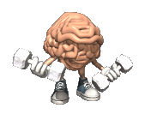
How to grow your brain!
Mindset

Slide 2
Hello!

Slide 3
Important Announcements
Playground Behaviour
Lunch Routine
First Aid
Toilets
Line Points
Wet Plays

Slide 4
The Good
60
50
40
30
20
10
00
Tell the person sitting next to you
what you are good at and
why?
Notes:
Show out of ten, how much effort you have out into it.

Slide 5
The Bad
60
50
40
30
20
10
00
Tell the person sitting next to you
what you are bad at and
why?
Notes:
Out of ten, how much effort have you put into it.

Slide 6
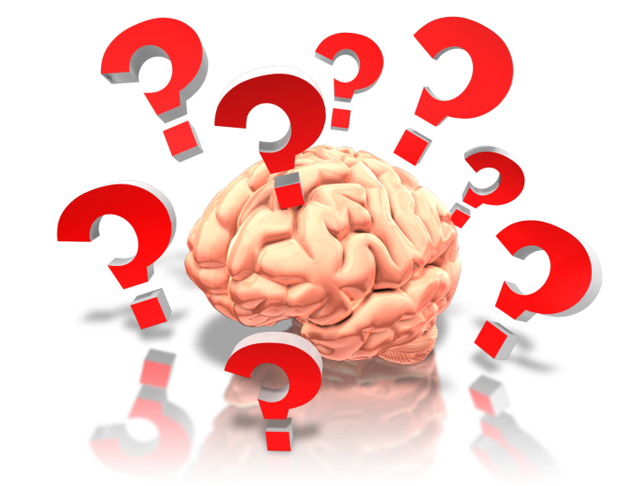
How does your brain learn?
Nobody is born able to walk, count, read or write!
How does a baby learn to eventually walk and then run?
How do we learn to talk?
Making mistakes is how you learn!
Notes:
No baby thinks I can’t do it and almost all babies learn at different times in different ways. ‘Aw Gone’, ‘Dow’, ‘Beff’ Difference between Kate and Beth. Maybe Kate had more practice but both will be able to talk.
Beth – fast at running. Jumping Bean, slower at talking. More practice!
Don’t think I’m not good at that, I cant do that. Keep trying. Falling over. Can’t be understood. Babies have growth mindsets.
Lots of children and grown ups get fixed mindsets. They worry they’ll look silly if they make a mistake, or they are a failure if they don’t get it right.
Your brain learns from making mistakes. It actually grows when you make mistakes and when you challenge yourself!

Slide 7
Did You Know?...
We learn and our brains grow when we make mistakes!

Slide 8
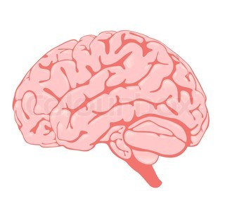
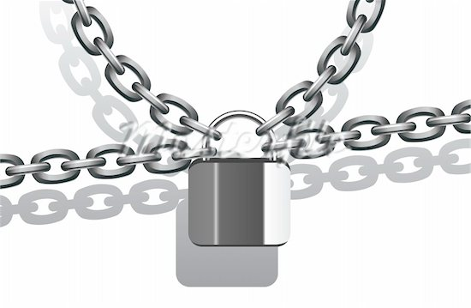
Which one are you?
Or a
?
Fixed
Mindset
Mindset
Notes:
Problem – a mindset is what you think
Some people think you are born clever or not
Good at maths or not
P7 said the ‘smart boy’… You are all smart!
BELIEVE you can get good and choose to practice!
Always said I am not very good at piano… but I don’t practice enough!
Problem is people who have a fixed mindset think they are very good at something until they get stuck. Then they think they are rubbish.
Someone with a growth mindset knows to learn they have to hit a challenge and try their best to get past it and they will learn and their brain will grow.

Slide 13
Never never never never never never never never
…GIVE UP!
Notes:
No superpowers
Had to train and train
Why do we fall down Bruce? So we can get back up!

Slide 14
Stronger!

Slide 15
Challenge

Slide 16
Which one are you?
?
Fixed
Mindset
Or a
Mindset
I give up…

Slide 17
Which one are you?
?
Fixed
Mindset
Or a
Mindset
Is this really my best work?

Slide 18
Which one are you?
?
Fixed
Mindset
Or a
Mindset
It’s good enough…

Slide 19
Which one are you?
?
Fixed
Mindset
Or a
Mindset
I can’t do it …yet

Slide 20
Which one are you?
?
Fixed
Mindset
Or a
Mindset
I can’t make this any better

Slide 21
Which one are you?
?
Fixed
Mindset
Or a
Mindset
I can’t do it…

Slide 22
Which one are you?
?
Fixed
Mindset
Or a
Mindset
I give up…

Slide 23
Which one are you?
?
Fixed
Mindset
Or a
Mindset
I’m amazing at this…

Slide 24
Which one are you?
?
Fixed
Mindset
Or a
Mindset
This is too hard…

Slide 25
Which one are you?
?
Fixed
Mindset
Or a
Mindset
I’m going to train my brain in this…

Slide 26
Which one are you?
?
Fixed
Mindset
Or a
Mindset
I’m going to figure out how he does it so I can try it…

Slide 27
Talent Spot
How did they get good at their talent?
Fixed Mindset – They are really clever and just good at it.
Growth Mindset – They must have practised
lots!

Slide 28
I Feel Good

