Slide 1
Determination

Slide 2
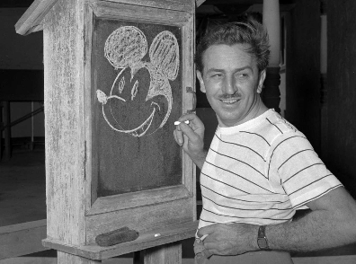
Walt Disney
Walt Disney was fired from an American newspaper, the Kansas City Star, because ‘he had no imagination and lacked good ideas’.
He went on to create some of the most famous characters and films in history.

Slide 3
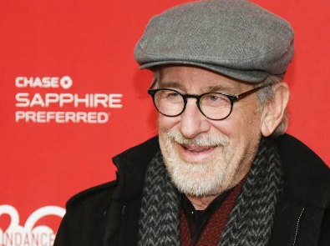
Steven Spielberg
He was rejected by a famous American school of cinematic arts several times!
He now has 3 Oscars, 4 Emmys and his films have made over 9 BILLION dollars!

Slide 4
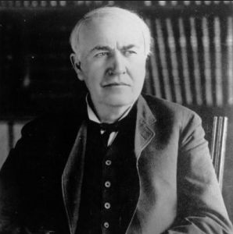
Thomas Edison
He was told by his teachers that he was, ‘Too stupid to learn anything’.
He later invented the electric lightbulb, the movie camera, a phonograph (an early record player) and held over 1100 patents!

Slide 5
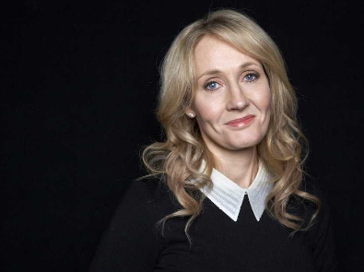
J K Rowling
JK Rowling was an out of work single mum, whose ideas for a series of books about a boy wizard were turned down lots of times.
She is the first billionaire author in the world! All thanks to Mr Potter!

Slide 6
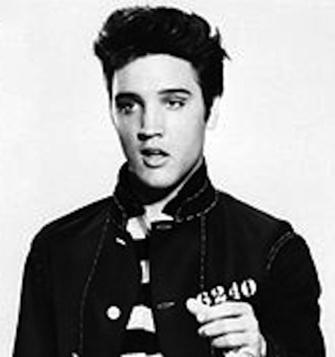
Elvis
After one of his first concerts, the concert manager said he was better off going back to driving trucks.
His music has now sold more than one billion albums!

Slide 7
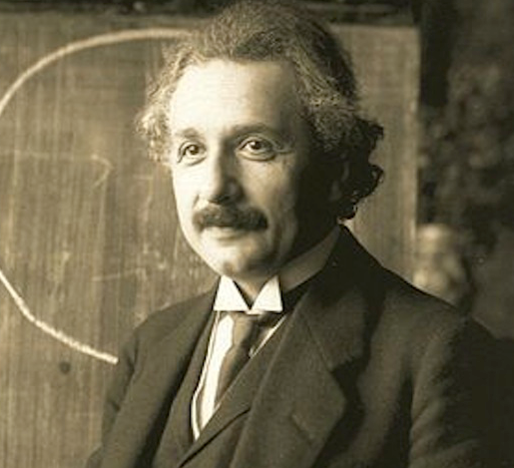
Einstein
He struggled at school, did not speak until he was 4 and did not read until he was 7. He was then expelled!!
He is now recognised as one of the greatest thinkers the world has ever known.

Slide 8
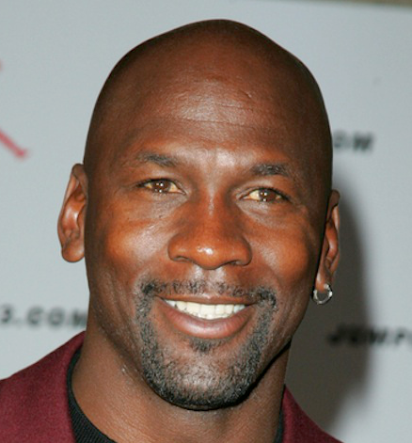
Michael Jordan
He was cut from his high school basketball team. He once said, “I have missed over 9,000 shots in my career. I have lost almost 300 games. On 26 occasions I have been entrusted to take the game winning shot, and I have missed. I have failed over and over and over again in my life. And that is why I succeed.”

Slide 9
Enough celebrities!
How about a normal person who has shown great determination?
Claire Lomas

Slide 10
Claire Lomas
36 years old
Paralysed from the waist down in a horse-riding accident
16 weeks pregnant
Decided to walk the Great North Run – a half marathon.

Slide 11
Claire Lomas
Used an exo-skeleton and crutches.
Took FIVE days to complete the event.
All to raise money for charity.
Now THAT is DETERMINATION!!!

Slide 12
Claire Lomas

