Slide 1
Improving Our Numeracy
5 Twilights April-June 2015
Early numeracy
Addition and Subtraction
Mental maths strategies
Multiplication and Division
Problem Solving
QIO Stephen Watters and class teachers both primary and secondary

Slide 2
Background
SSLN- have shown there are gaps in basic number-basic number skills are the key.
Repetition and daily practise is essential.
Start- Prior knowledge, observations, discussions and initial assessment.
Leave formal written work in jotters until the children fully understand what they are writing- may take longer for others.
From the beginning of primary 1 use the language of maths e.g. greater than, less than, how many more etc.
Class discussions- Why do we have to learn to add?

Slide 3
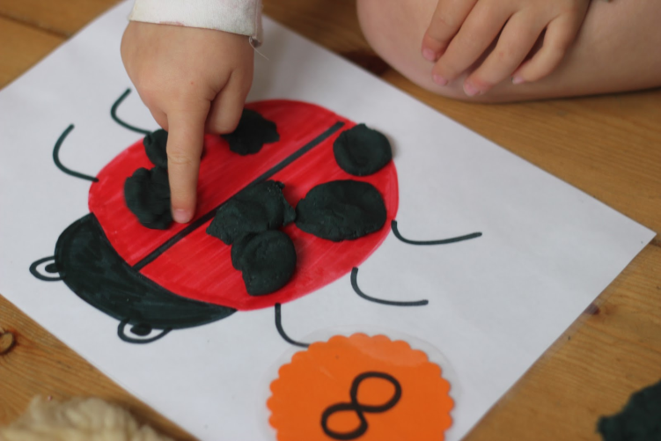
Problem solving- teach more word problems from primary 1 e.g. 5 on the bus and 2 get off- how many are left?
Variety of different types of resources e.g. concrete materials, songs, multisensory etc.
It is essential that children understand that a number is an amount- 1:1 touch and count correspondence.

Slide 4
Subitising
Subitising: The ability to recognise patterns in numbers.
e.g. look for the patterns- 2 groups of 3, a group of 4 and a group of 2, 3 groups of 2 etc. It is the ability to recognise the no. of objects in a small group, without counting them- fundamental numeracy skill.

Slide 5
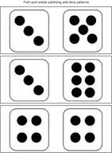
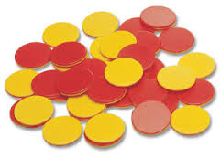
Ways to subitise
Set finger patterns e.g. use your fingers to show me 2, show me another way- ‘throw it’ game: hide fingers and teacher shouts throw me 4- children display fingers from behind back without counting.
Use dice and dominoes- the children recognise the amount without counting the dots.
Coloured counters
Taught with recognition of numbers, counting and counting on-before addition and subtraction
https://www.youtube.com/watch?v=aBV3XnRjZoA

Slide 6
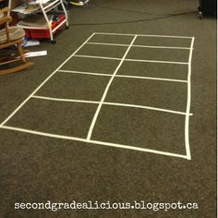
5 and 10 frames- A great resource.
Counters with different colours on the opposite
Sides. Roll the dice and some will be yellow and some red- helps with number bonds
10 frames also help with teen numbers e.g. 22 would be 2 full ten frame and 2 coloured on the other 10 frame etc. Instant recognition
You can use tape to make a 10 frame on the carpet- put objects in to show e.g. 5- how else could you make 5, now make 7, can the children add on from 5 without having to clear off all the objects?

Slide 7
Notes:
HELPS TO BUILD A SOUND KNOWLEDGE OF BASIC ADDITION AND SUBTRACTION FACTS TO 10 AND MORE.
ALSO VERY IMPORTANTLY TEENS NUMBERS AND EARLY PARTITIONING.THEY CAN GROUP TENS AND 1’S TO MAKE TEEN NUMBERS
THEY CAN ALSO HELP CHN TO FIND THE MISSIMG NUMBERS SUMS-2+?=5

Slide 8
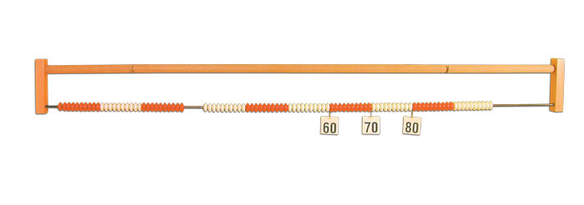
Bead bars or number stick- great resource- can the child find the number e.g. 52
Always ask the children to ‘justify’ their answer. E.g. how did you know that was 52 on the bead bar?
It is essential that children are not going to abstract too quickly- no written work until they have the understanding- they need to be able to touch it and see it.
Let the children take the lead and be the teacher- e.g. number fans, games etc.
It is essential that addition and subtraction are taught at the same time- also multiplication and division.
SEAL box in every class- same resources e.g. 10 frames but adapted depending on stage.

Slide 9
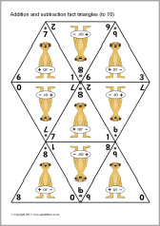
Teach commutative law: 3+1=1+3
Teach compensation: adding 11 is the same as adding 10 then 1
+/- triangles

Slide 10
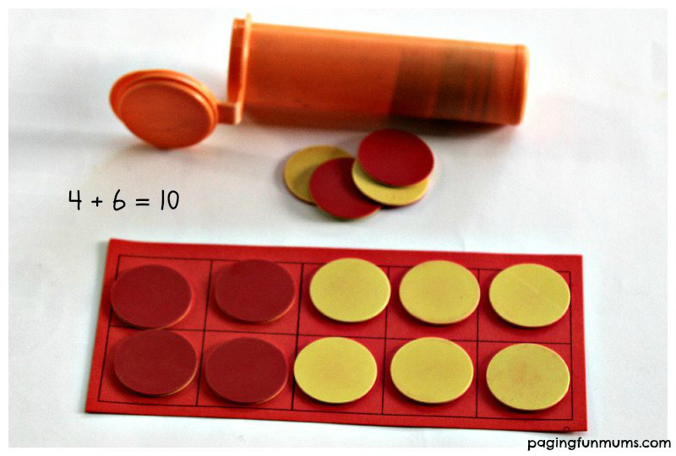
Resources
SEAL boxes- Stages of Early Arithmetic Learning- in each class
5 and 10 frames
Bead bars
Dominoes
Dice
Number lines
Abacus
+/- triangles- great resource

Slide 11
Online resources/websites
Illuminations- website
Harvey's Homepage- Website
Glasgow online-maths- curricular area-numeracy-primary resources
Numeracy Academy- East Lothian
Games
I say a number you say the next/previous e.g. teacher says 4,5,6 and pupil says 7,8,9
Counting choirs- split the class into groups. Ask one group to start counting then stop them and the next group carries on etc. forward and back, in 2’s or 5’s etc.
Guess the position- put a number line out with e.g. 0, 10,15 and 20. Can they play where 4 would go, 18 etc.
Guess the number- child thinks of a number and the other children have to guess with yes or no answers e.g. is it bigger than/smaller than
Dice game- roll two dice 2 and 4- what numbers can you make 24 or 42- what number is biggest/smallest etc. adapt e.g. 3 dice for HTU

Slide 12
Planning and resources
Glow resource- progression pathways. This is a maths resource/planners show where to start in each level in each area within maths.
There are lesson ideas, resources and homework ideas.

Slide 13
Maths strategies
Mental maths daily
Pupils should be taught different strategies
Pupils should explain methods/compare to other methods
Teach written methods after teaching understanding e.g. vertical and horizontal sums.
Use various resources from p1-p7

Slide 14
Activity
There are 47 children in the hall. 28 more arrive, How many are in the hall now?
How did you work it out?
Can you think of other strategies?
Share strategies.
Some people prefer to use certain strategies- but teach/model various.

Slide 15
Strategies- 47+28
40+ 20 then 7+8
Vertical sums
Rounding/ compensation- 47+30-2
Open number line- visualisation
Compare strategies- Easiest? Quickest?
+20 +3 +5
47 67 70 75

Slide 16
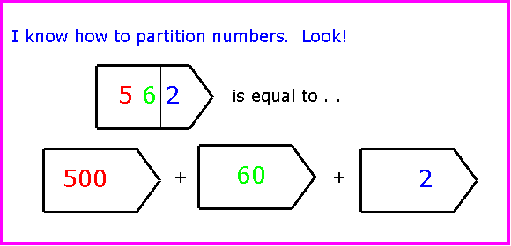
Re-ordering, Partitioning and Compensation
Re-ordering
2+7 easier as 7+2
17+9-7 easier as 17-7+9
Partitioning
4+15= 4+10+5
30+47= 30+40+7
Compensation-rounding
24+19= 24+20-1
84-18= 84-20+2

Slide 17
Multiplication and Division
Various methods
Open number line- 4x2=8 Use language 4 jumps of 2 before 4 multiplied by 2
Arrays
+2 +2 +2 +2
0 2 4 6 8

Slide 18
Pictures/grouping

Slide 19
Multiplication- Rectangle method
18x10
10 8 100+80=180
10 100 80
14x16
10 6 100+40+60+24=224
10 100 60
4 40 24

Slide 20
29x17
10 7 100+100+70+70+90+63=493
10 100 70
10 100 70
90 63
424x36=15264
400 20 4
30 12000 600 120
6 2400 120 24

Slide 21
Try it…
356x42

Slide 22
300 50 6
40 12000 2000 240
600 100 12
12000
2000
240
712
14952

Slide 23
Websites
SSLN- http://www.educationscotland.gov.uk/learningandteaching/assessment/ssln/
National Numeracy Progression Framework- better understanding of progression within numeracy
http://www.educationscotland.gov.uk/resources/n/nationalnumeracyprogressionframework/index.asp?strReferringChannel=video&strReferringPageID=tcm:4-867428-64&class=l3+d220068
Illuminations- website https://illuminations.nctm.org/
Harvey's Homepage- Website http://harveyshomepage.com/Harveys_Homepage/Number_Sense.html
Glasgow online-maths- curricular area-numeracy-primary resources
Numeracy Academy- East Lothian http://numeracyacademy.edubuzz.org/

