Slide 1
Healthy Snacks in Elmvale

Slide 2
When?
EVERYDAY if you can!
Focus days
Tuesday
Wednesday
Thursday

Slide 3

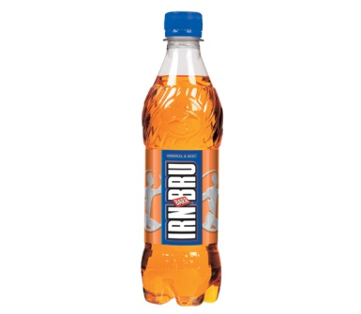
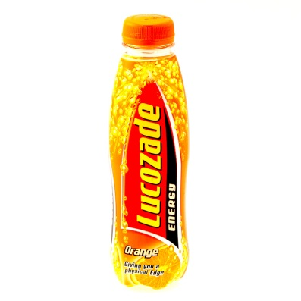
Drinks
Water can be drank at any time in class
(bring a filled bottle to school everyday and refill at lunch if needed)
~
NO FIZZY DRINKS OR ENERGY DRINKS ARE ALLOWED
(EVERYDAY OF THE WEEK)

Slide 4

Lotto tickets
Healthy Snack
Star Lotto
Name______________________
Class _______________

Slide 5
Who gives lotto tickets?
Adults in the playground
~
Teachers in the classroom
~
‘Snack busters’ in the playground

Slide 6
Snack Busters
2-3 members of the Health group will be in the playground each day.
~
They will give out lotto tickets for children with health snacks.

Slide 7
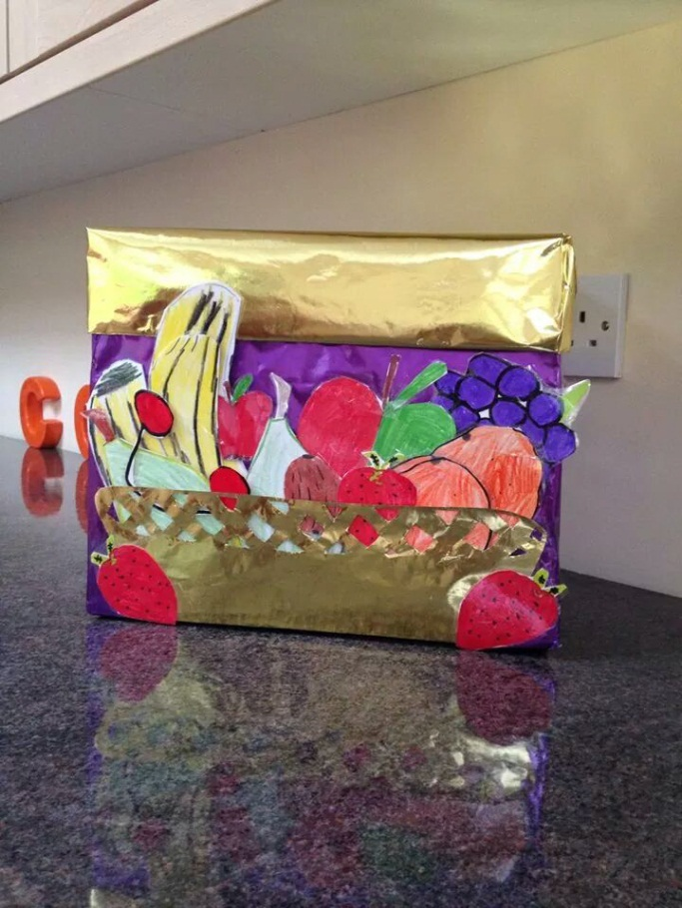
Healthy Snack Lotto Box
Separate box to post your healthy snack lotto ticket into.

Slide 8
Healthy Snack Lotto Box
One lotto ticket will be drawn at each assembly.
~
The last Friday of every month – Healthy Snack winners will go to Turus Room 1-2pm for a treat.

Slide 9
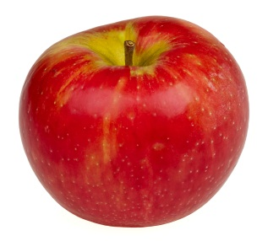
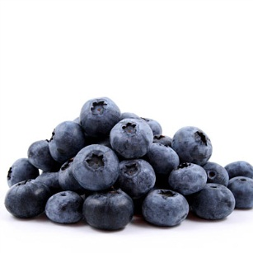
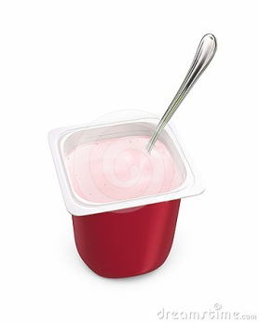
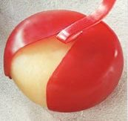
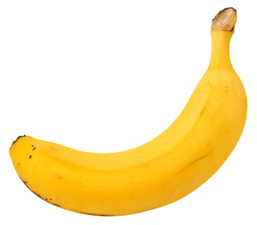
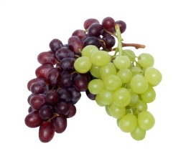
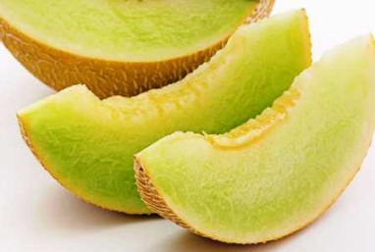

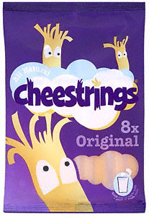
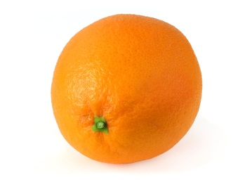
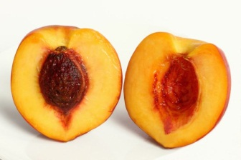
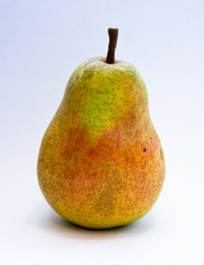
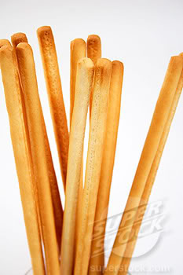
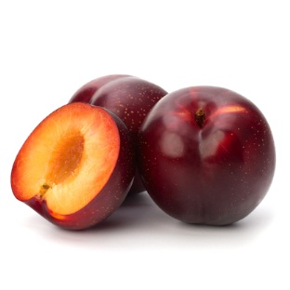
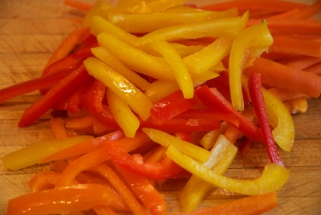
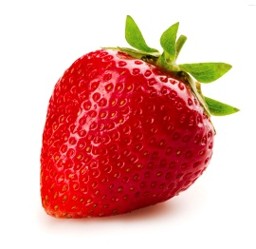
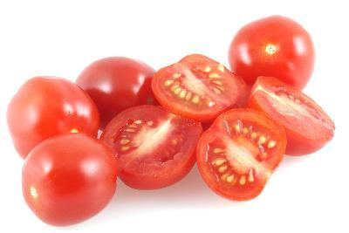
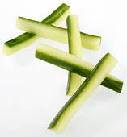
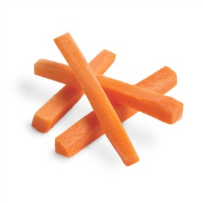
What kind of snacks?
NO NUTS!

Slide 10
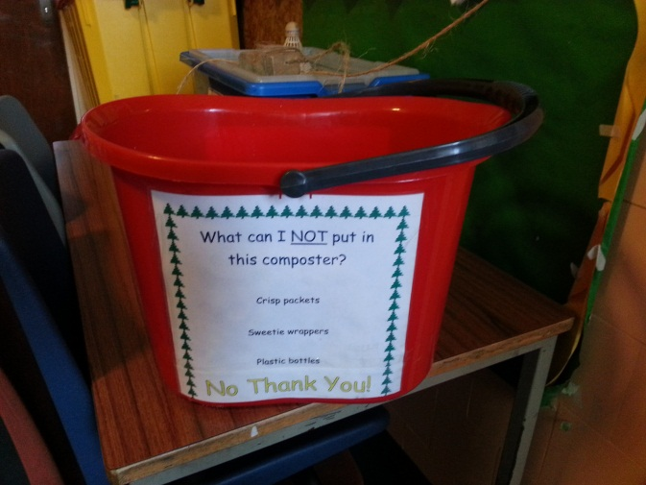
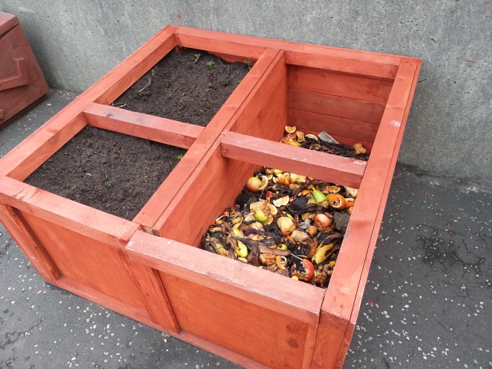
Help us to be an ECO school
Remember to put your leftover fruit and vegetables in the compost bucket or bin.
We will use our compost to help our plants and flowers grow better.

