Slide 1
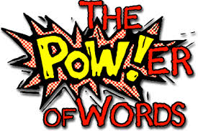
Notes:
We know it’s wrong to use our hands or feet against other people.
Let’s think about what our words can do to other people...
Last week we thought about how we all have a point of view. Remember 2 girls, upset with one another, but didn’t find out each others story. We talked about ready steady go... Calm, talk and listen. Someone listened so well, she suggested trying to do a ready,steady go with someone she has been having friendship problems with and arguing with. Mrs Baker and I PROUD!
Our words are VERY powerful... They can change our feelings... And sometimes change people.
Sometimes we can heal with our words and sometimes we can harm

Slide 2
Words Can Change How You Feel
Think about this word...
What does it make you feel?
What pictures enter your mind?
CHOCOLATE
Notes:
Words can make you picture good things in your mind
Let’s try this one

Slide 3
Words Can Make You Smile
(Joke Time)
Notes:
Words can make you smile or laugh...
Why do bees have sticky hair?
Because they use honey combs
Why is 6 afraid of 7
Because 7 8 9
Why do cows wear bells
Because their horns don’t work
Knock Knock
Who’s There
Boo
Boo Who?
Please don’t Cry, it’s only a joke

Slide 4
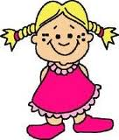
Words Can Make You Feel ...
‘You are a special person’
‘You look fantastic’
‘Thank you’
‘Play with us’
Notes:
Ask how you might feel if you were told these things...
Kind words can make you feel more confident, happy and calm
With our words we can change not just people’s feelings, but people themselves. For instance, someone who is an ordained minister in the Church can change people and make them different just by saying a few words. You don’t mean that a minister can change someone from being a boy to being a frog! It’s not like magic! But a minister in the Church can conduct weddings. And when in a wedding a minister says the words, ‘I therefore proclaim that you are husband and wife’, the minister is actually changing the people from being two separate single people to being a married couple. Another example is in a law court. When a jury or a judge says that someone is guilty or not guilty of a crime, that person’s life is changed for ever. Or take doctors. Doctors have a lot of power when they have to give patients good or bad news. Words are powerful.

Slide 5
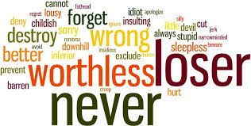
Notes:
Truth is words can harm, as well as heal...
If someone says something hurtful, you can try hard to ignore but it’s hard!

Slide 6
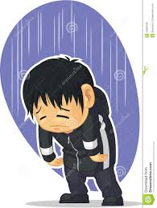
Words Can Make You Feel...
‘You are stupid’
‘I’m going to get your friend’
‘My Dad is going to get you’
‘You look like...’
‘You smell like...’
Notes:
Ask how these might make you feel...
Upset, wound up, embarrassed, nervous, scared, down, depressed... angry

Slide 7
Notes:
Talk about problem with some children being unkind to each other.
Problem is with harmful words...children can get stuck in a loop trying to get each other back!
Spoke to two children who have been saying unkind things to each other last week.
They couldn’t remember who started saying unkind things.
They both felt annoyed at each other.
They both felt rubbish!
Their friends took sides and joined in.
They said unkind things to each other in class.
This continued in the playground.
Then one person eventually lost their temper
Someone used their hands and feet
How did it start?... With words!!

Slide 8
Notes:
Sometimes unkind words are coming from both sides...How do we stop the circle of using hurtful words to one another?
Sometimes, the words are coming from one side and you are not doing/saying anything (bullying) If it is one sided, speak to an adult privately, add a message to a worry box and remember SILENCE against the unkind words is as powerful as words.
You can choose to not let the words have as much power by not reacting back to the person, but speak to a friend.

Slide 9
Notes:
All staff are here to help children who are being hurt by words.
If you use your words to hurt, you will have serious consequences.
So...

Slide 10
Notes:
We are taking this seriously and children who can’t fllow this rule may be kept in for detention, may have parents involved, may miss treats such as discos/ trips/ treats

Slide 11
Notes:
How can we use our words to make people feel good and happy? What must we not do with words? (Say nasty things to people, make them feel bad.) We may not have the power of a judge or a doctor or a minister in the Church, but our words are powerful just the same.

