Slide 1

Numeracy in P1

Slide 2
Numeracy and Mathematics
CfE Early level numeracy and mathematics is divided into 8 sections
Number
Money
Measure
Time
Patterns and relationships
Shape
Angles and symmetry
Data analysis

Slide 3
Active learning
Already exposed to numbers
Numeracy exciting and fun for children
We need to make numeracy relevant and engaging for them
Curriculum for excellence creates opportunity for active learning
Active learning is about children exploring, investigating, problem solving and challenging children in a variety of ways using a variety of resources

Slide 4
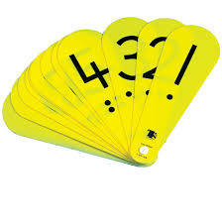
Resources and Assessment
Singing and rhymes, workbooks, flashcards, ICT, number fans, 10 frames, multisensory activities and outdoor learning.
Within numeracy the children and teachers will work together to set goals and targets
Assessment- observations, Learning Blethers, written work and testing, self and peer assessment.

Slide 5
What you can do to help at home…
Provide opportunity for numeracy e.g. counting cars, expose them to coins when out shopping, numbers on buses, shapes in the environment etc.
Songs and singing about numbers
Days of the week, months of the year and seasons
Practise number formation
No pressure

Slide 6

Health and Wellbeing

Slide 7
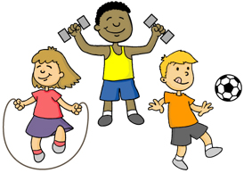
Physical Education
Children will receive 2 hour slots of gym per week.
On these days they should have a change of t-shirt, shorts and appropriate footwear.
You can buy an Elmvale gym kit from the office.
Gym Shoes – only velcro or slip ons please.
Please ensure children are not wearing jewellery on these days.

Slide 8

Healthy Eating
At Elmvale, we try to encourage the children to be as healthy as they can.
It would be fantastic if you could do so as well and provide your child with a healthy snack.
Children can also bring a water bottle to school with them (please label these). We do not allow children to bring fizzy juice or lollipops.
We will be covering healthy eating and hygiene this year and will be discussing tooth brushing etc.

Slide 9

Peer Mediation
Restorative Approaches and the Golden Rules
Children will sign a behaviour contract and will know the Elmvale Golden rules. Although, as far as possible, Restorative Approaches will be used, this will be in conjunction with earning Golden Time minutes.

Slide 10
Peer Mediation
A restorative approach is often used by staff to help all children in the c=school to resolve minor disputes and arguments. It helps the children take responsibility for their behaviour AND for the solution.

Slide 11
Peer Mediation
Each day, 4 Primary 7 children will be available in the Infant playground to help P1-3 children solve any minor disputes. The P7 children have been trained in Restorative Practices.

Slide 12
Peer Mediation
What is it?
Peer Mediation is a process where children who are involved in a dispute or argument are helped by older children
to resolve it by working together.

Slide 13


Home Learning
Home learning- learning activities at home in replacement of the term ‘Homework’.
Aim- reflection, consolidation of work and parental involvement.
10-15mins (approx) 3-4 nights per week.
Home learning workbooks- 1 page per night.
Home learning grid- 1 activity per week.
Reading
Communication Jotter

Slide 14

Golden Rules
We do our best
We are honest
We are kind and helpful
We show respect and good manners
We look after property
We walk quietly around the school

Slide 15

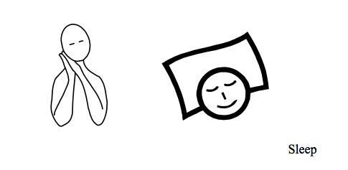
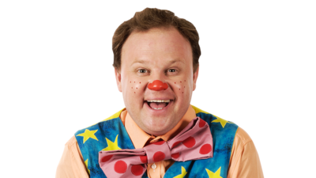
Makaton
Makaton is a language programme using signs and symbols to help people to communicate. It is used by many people who find it difficult to use verbal communication. It is designed to support spoken language.
Makaton is regularly used in mainstream schools, to support all children to develop communication, language and literacy skills.
Inclusion
1-2 signs and symbols per week in Nursery and Primary 1.
Mr Tumble
Top Tips:
Using Makaton is fun!
Use signs and symbols as much and as often as you can.
Always speak as you sign or use symbols.
Offer lots of encouragement.
Don't give up!

